Slide 1
GroGro
The food tracking web app
By Sarah Abrahamson, Rob Russo, Peter Ryder, Jessie Sodolo

Slide 2
Overview
What is GroGro
Project Plan
Project Methodology
Task Assignments
Architecture
Technologies
Demo
Conclusions
Questions

Slide 3
What’s GroGro?
A food tracking site which pulls nutrition data from the USDA and displays that information with fun and easy to understand visualizations
The nutrition data provided is: Energy, Fat, Carbohydrate, Fiber and Sugars
A RESTful service
Mobile friendly

Slide 4
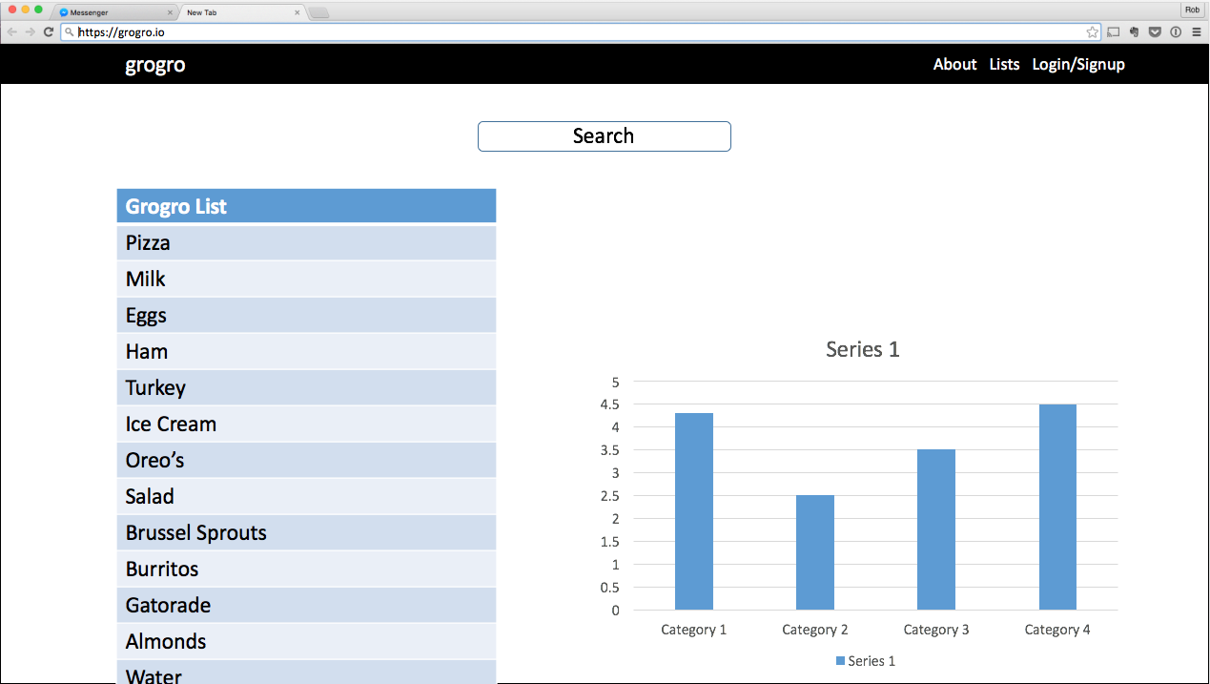
Project Plan
Start early, iterate often
Do the hardest things first
Track Issues on Github
Emulate the prototype
Notes:
Mainly focused on the API call first, then worked on the graph and then set up the database and additional features.

Slide 5

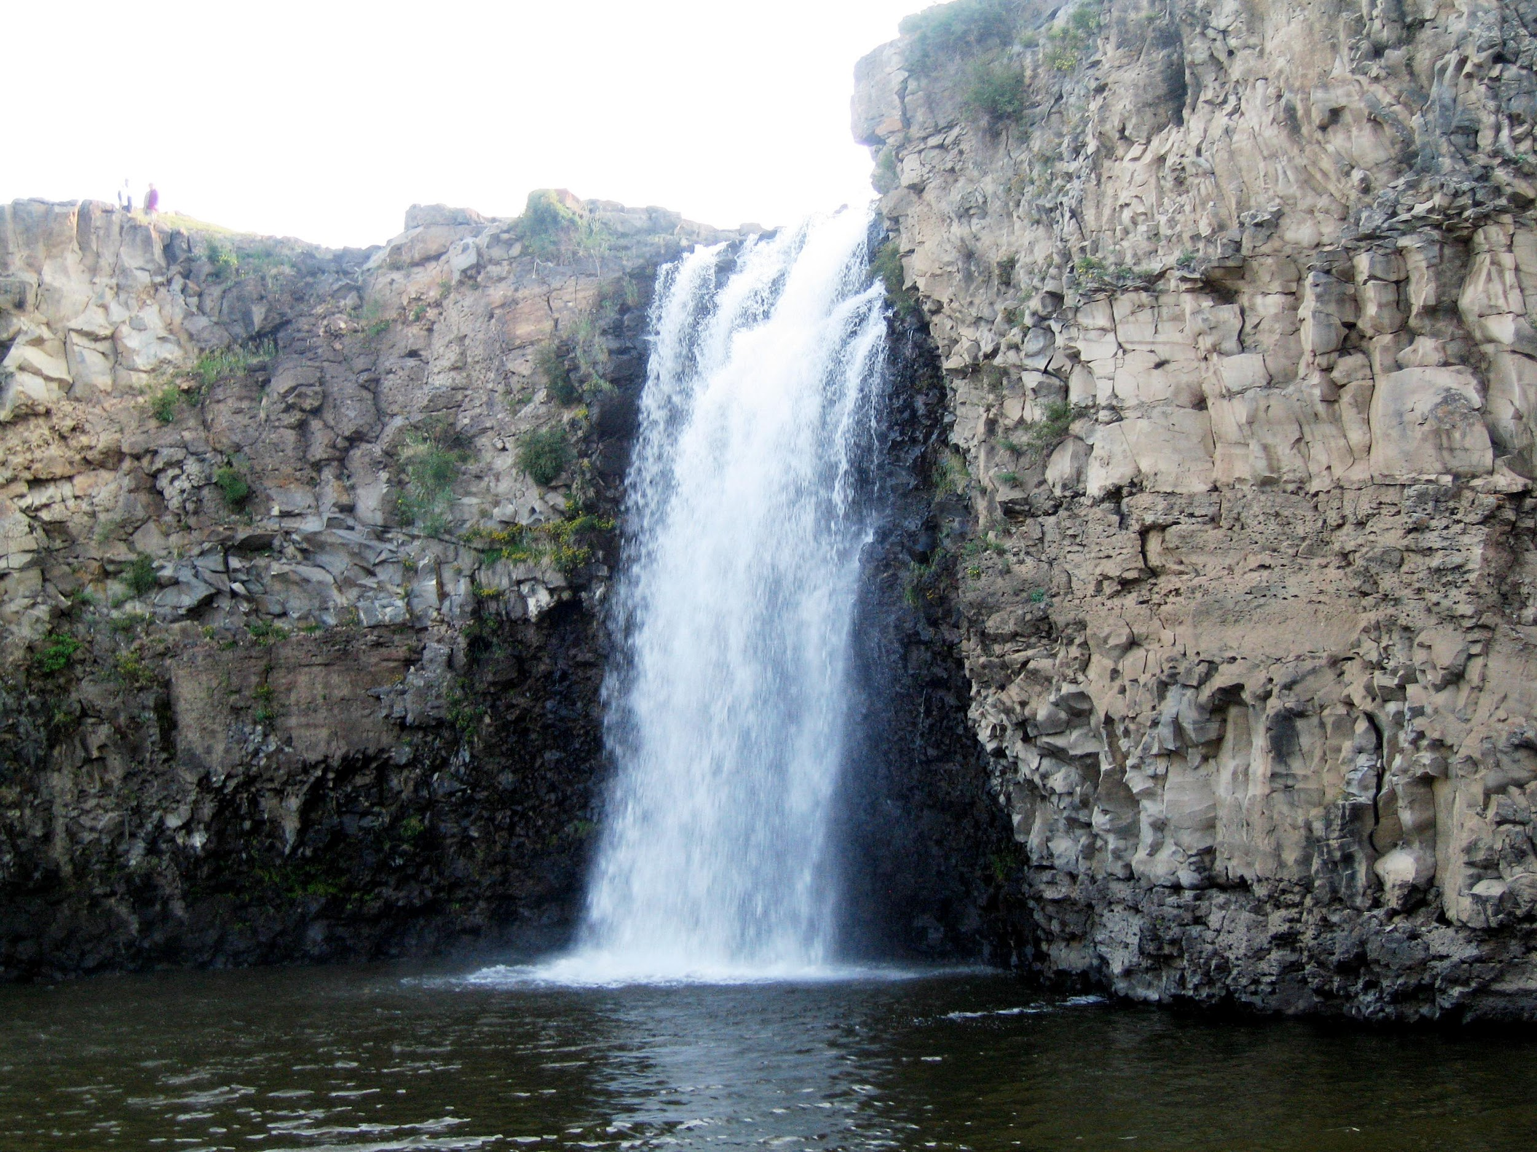

Project Methodology
Notes:
Waterfalll - used Facebook messenger to commute along with team meetings
Created multiples branches in github to test locally before pushing to master

Slide 6

Task Assignments
Assigned issues through Github
Assign a person to a task based on interest and skillset
Work full stack
Notes:
Peter - Backend, worked with the API
Rob - Front End
Jessie - Front End
Sarah - Database and Facebook API

Slide 7
Architecture - Database
Items - Store Food Nutrition
Users - Store FB ID
Lists - Store Lists of Foods
Notes:
Peter
Items store food nutrition
Users store fb information
Lists store many food items

Slide 8
Architecture - API
/api/get_food/:food - Returns USDA ID for food name
1 API call to USDA gets all IDs which could be what user requested
/api/get_nutrition/:food_id - Returns nutrition from USDA ID
1 API call per food - This adds up quick!
API calls interact with database - need to be logged in
Notes:
get_food returns a usda id for a food name - useful when searching for foods by name
get_nutrition returns nutrition information when given an ID as input

Slide 9
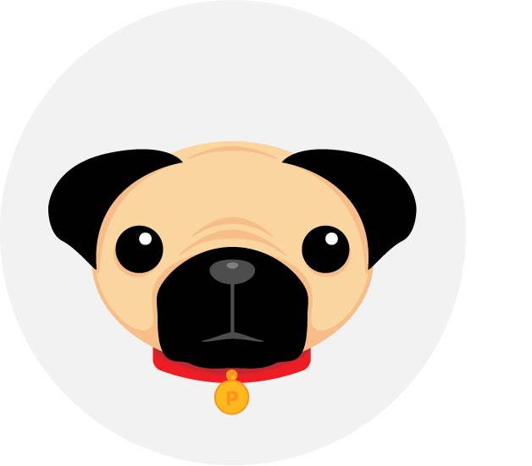







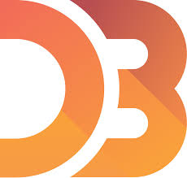

Technologies
Notes:
Peter
Node for server
Mongo/Mongoose for DB
Heroku for hosting
Angular
Jade
D3
Split up into frontend/backend technologies probably

Slide 10


Services
Notes:
Peter
Node for server
Mongo/Mongoose for DB
Heroku for hosting
Angular
Jade
D3
Split up into frontend/backend technologies probably

Slide 11
Demo
https://grogro.herokuapp.com/
Notes:
Rob

Slide 12
Conclusion
MEAN Stack Development
The value in starting early
SVGs aren’t images
Respective strengths and weaknesses
Notes:
Rob

Slide 13
Thank You
Questions?

